Slide 1
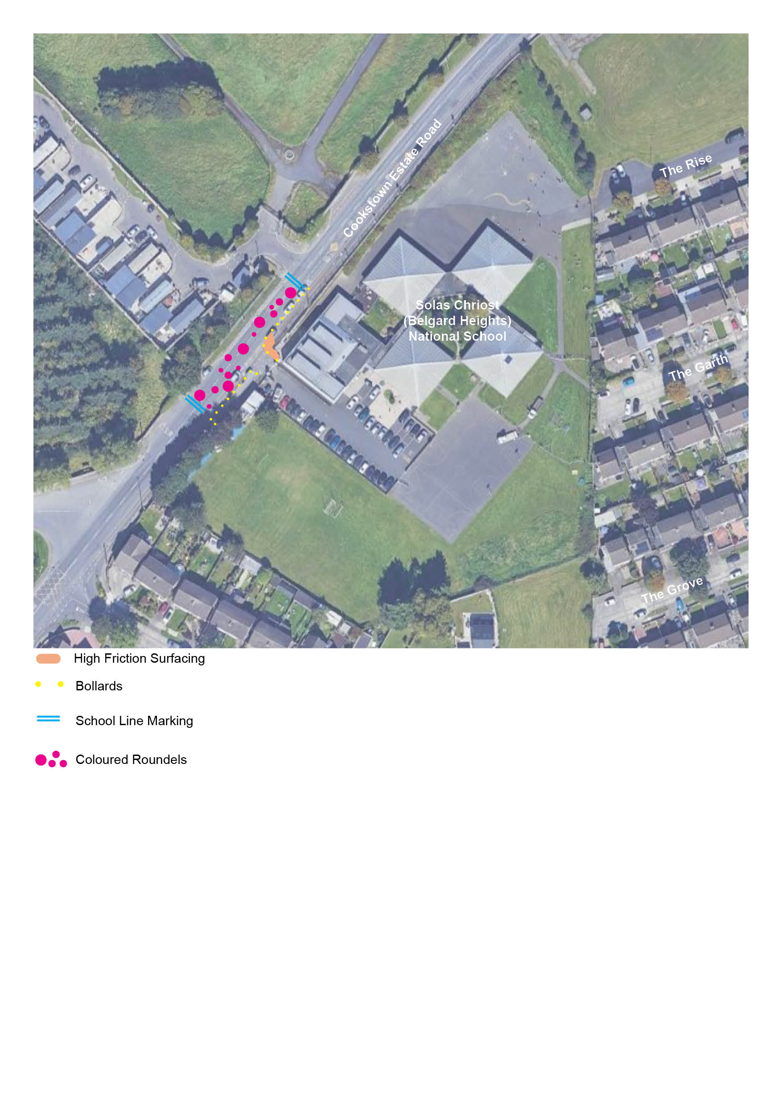


Safe School Zone Works at Belgard Heights NS (Solas Chriost) Cookstown Road
What is in this Leaflet
Description of the Works
Reasons for the Works
When the Works will be carried out
What is Proposed
Improved road markings and coloured road markings road surface in front of the school to highlight the visibility Belgard Heights NS (Solas Chriost), encourage slower driver speeds and discourage illegal parking
Installation of pencil bollards along edge of kerb and at pedestrian entrance, to prevent parking near and at the school gate.
Works will be carried out under Section 38 road Traffic Act, 1994, following non-statutory public consultation in June 2026
Things To Know
Location of works : Cookstown Road
Access to Belgard Heights NS (Solas Chriost) will be unaffected by these works
The works are intended to take place in July and August to minimise disruption.

Slide 2
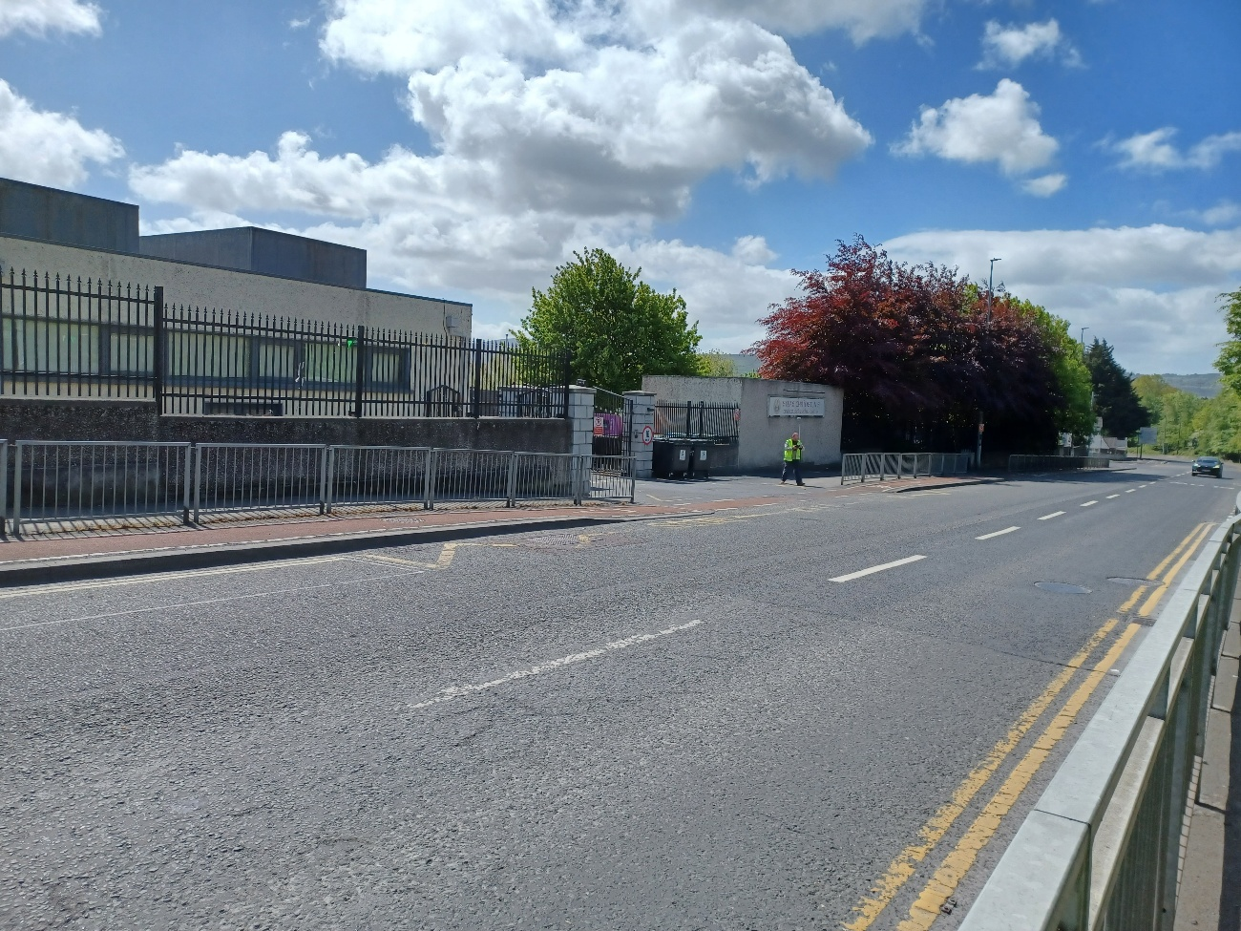
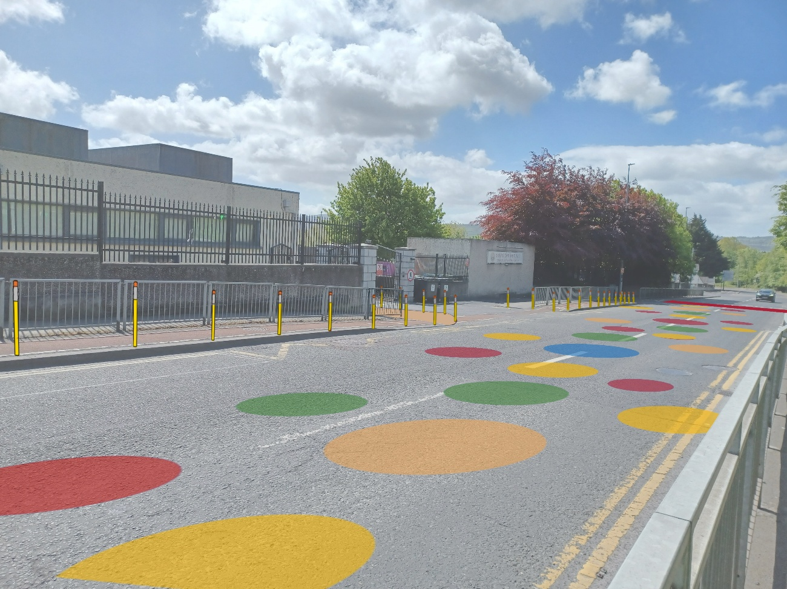
Why is this change proposed?
There can be uncertainty around any road changes, and it can hard to imagine the future. Here are some reasons for this change;
Local Benefits
Benefits include reduction in vehicular speeds & better crossing facilities for school children and older residents
Safer access to and from school for children
Similar schemes have increased the numbers of people walking and cycling to school and helped make the area safer and more pleasant and attractive
Safer walking and cycling facilities allow more people to choose to walk or cycle for short trips.
Reduced traffic congestion will improve air quality at the school gate
Wider Benefits
Encouraging people to walk and cycle rather than driving when they can, helps:
Improve road safety particularly for the elderly and children
Reduce emissions causing climate change
Improve our overall mental and physical health
Creates economic benefit for individuals and society
Existing
Proposed
Contact
Email: activetravel@sdublincoco.ie
Customer Care Portal: https://customercare.southdublin.ie/
A short non-statutory consultation will take place from
23/06/2026 to 14/07/2026 https://customercare.southdublin.ie/

